Slide 1
Neural Network Architectures and Debugging

Slide 2
What is the best architecture for my problem?
There is no set rule on how to design the best network.
More hidden layers, units means more parameters that need to be optimised. This will result in longer training time.
Various people state certain guidelines. For example: number of nodes in hidden layers should be roughly equal to the number of inputs.

Slide 3
Architecture Design
For non-image data (for example feature based data) – say a vector of numbers which denote numerical features
Generally will be made up of fully connected layers and dropout. Dropout will help deal with overfitting.
Exactly one input layer
Exactly one output layer. How many nodes?
Regression problem - typically one node since you will be predicting one value. Some regression problems predict more than one value (so use more than one node)

Slide 4
Architecture Design
Exactly one output layer. How many nodes?
Regression problem - typically one node since you will be predicting one value. Some regression problems predict more than one value (so use more than one node)
Network Correct
prediction
5.0 7.0

Slide 5
Architecture Design
Exactly one output layer. How many nodes?
Classification problem - typically N nodes since you will be discriminating between N classes. You can use softmax function in the last layer which outputs probabilities for each class. Alternatively, use another function and pick the largest value.
Network Correct
prediction
0.9 1.0 class A
0.1 0.0 class B

Slide 6
Architecture Design
Start with one hidden layer.
Then gradually add some more.
Check the performance difference
Add dropout between layers.
Don’t start with dropout (this cuts off connections to inputs)

Slide 7
Architecture Design
Which activation function should I use?
People generally used sigmoid, then ReLU was proposed (but had a problem), leaky ReLU was proposed, then ELU…
Possible starting point (hidden layers): use ReLU or leaky ReLU, try ELU too.
Possibly read: https://medium.com/the-theory-of-everything/understanding-activation-functions-in-neural-networks-9491262884e0
Video: https://youtu.be/-7scQpJT7uo?t=288

Slide 8
Example
Consider a dataset with 20 inputs and 5 classes
Start with this model … then add a layer … …. Then try leaky relu…
Input – 20 inputs
Input – 20 inputs
Input – 20 inputs
20 units, ReLU
20 units, ReLU
20 units, leaky relu
Output, 5 units, softmax
10 units, ReLU
10 units, leaky relu
Output, 5 units, softmax
Output, 5 units, softmax

Slide 9
Example
Input – 20 inputs
Add dropout
20 units, leaky relu
dropout, prob = 0.2
10 units, leaky relu
Output, 5 units, softmax

Slide 10
Example
Consider a regression dataset with 10 inputs and 1 output variable
Start with this model … then add a layer …
Input – 10 inputs
Input – 20 inputs
10 units, ReLU
10 units, ReLU
Output, 1 unit, linear
10 units, ReLU
Output, 1 unit, linear

Slide 11
What about image datasets?
Similar strategy.
Add some convolutional layers with small kernels (50 filters at 3x3).
Then add max pooling after the convolutional layers.
More filters means it can learn more “features”,

Slide 12
Have a look at literature – VGG16

Slide 13
Start simple

Slide 14
Start simple – add complexity

Slide 15
CNNs
Generally will be input layer then
a sequence of convolutions and a max pooling,
more convolutions and a max pooling,
then end with fully connected layers.

Slide 16
Architecture Design
Which loss function?
For regression you are dealing with numerical data, so typically use mean squared error (to compute “distance” between prediction and true values).
For classification you are comparing classes, so typically cross-entropy

Slide 17
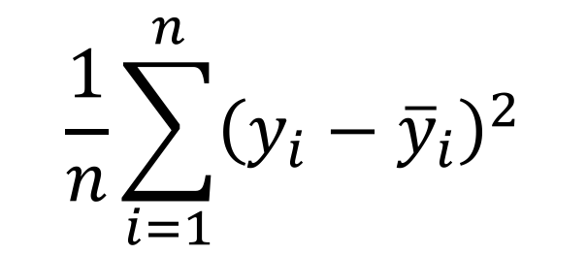
Network Correct
prediction
5.0 7.0
$$\frac{1}{n}\sum_{i=1}^{n}{{\left(y_{i}−{\overline{y}}_{i}\right)}^{2}}$$
MSE

Slide 18
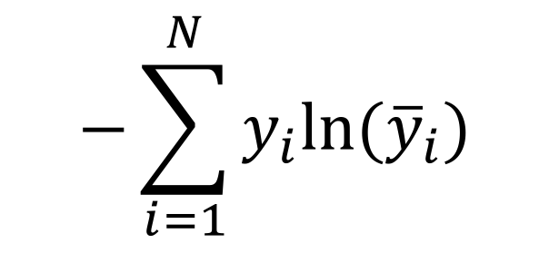
Network Correct
prediction
0.9 1.0
0.1 0.0
$$−\sum_{i=1}^{N}{y_{i}ln⁡({\overline{y}}_{i})}$$
Cross entropy

Slide 19
Debugging
Great article: http://theorangeduck.com/page/neural-network-not-working
Let’s summarise some points
You Forgot to Normalize Your Data (check neural-networks.ipynb)
You Forgot to use any regularisation
You Used a too Large Batch Size
You Used an Incorrect Learning Rate

Slide 20
Debugging
Your Network contains Bad Gradients
You Used a Network that was too Deep
Bad Initialisation
Wrong activation function in the last layer
mod$add(
Dense(units = 3,
kernel_initializer = he_normal(),
bias_initializer = he_uniform()))
Check https://cran.r-project.org/web/packages/kerasR/kerasR.pdf (page 28 “Initalizers ”)

Slide 21
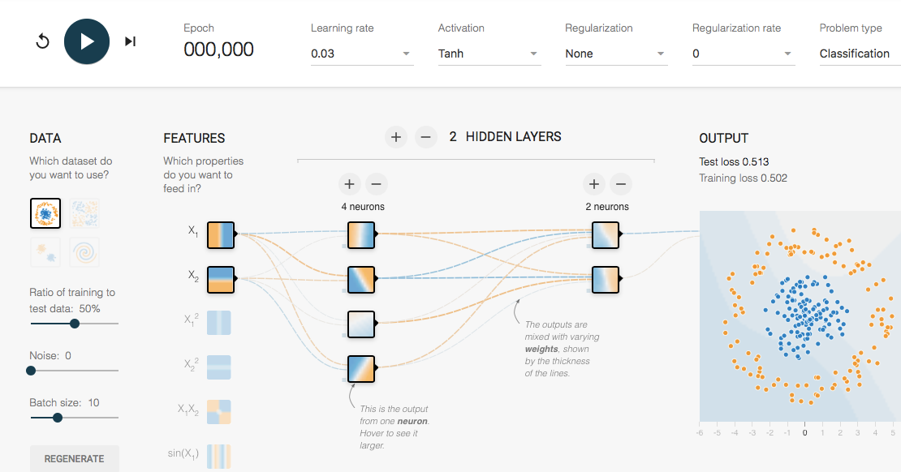
Playground
Play around with different architectures, layers and activation functions here: http://playground.tensorflow.org

